Slide 1
FHA Interoperability Use Case
Work Group
May 22, 2014

Slide 2
What is Interoperability?
In healthcare, interoperability is the ability of different information technology systems and software applications to communicate, exchange data, and use the information that has been exchanged.
Two key words: exchange & use
Three types of interoperability
  Foundational: lowest level
    Exchange, use, but not interpreted by information system
  Structural: intermediate level
    Exchange, use, syntax (data format), interpret at data level
  Semantic: highest level
    Exchange, use, interpreted by information system
      Syntax and codification of data supports interpretation
(HIMSS)

Slide 3
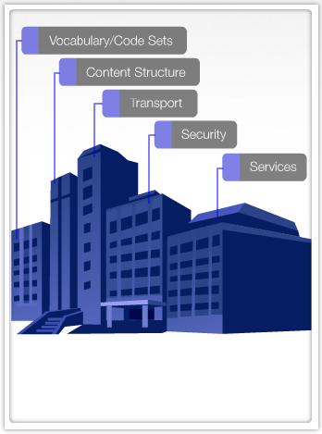
Interoperability Framework
Interoperability needs a standards framework
  Required standards for implementation
  Includes:
    Vocabulary & Code Sets
    Content Structure
    Transport
    Security
    Services
MU 1 included standards for
  Vocabulary & Code Sets
  Content Structure
  Security
MU 2 includes Transport & Services
(HHS, ONC)

Slide 4
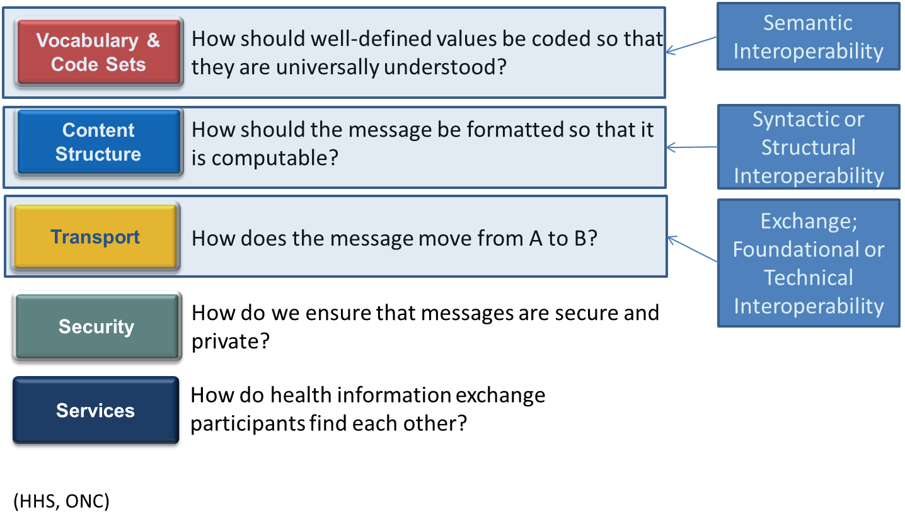
Interoperability Framework

Slide 5
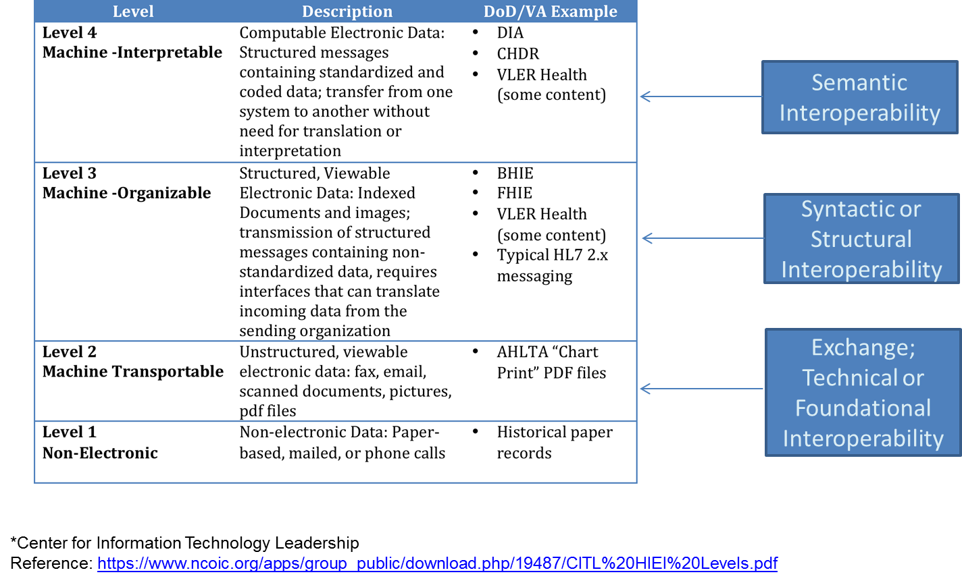
CITL* Levels of Interoperability

Slide 6
Syntactic interoperability definition
If two or more systems are capable of communicating and exchanging data, they are exhibiting syntactic interoperability. Specified data formats, communication protocols and the like are fundamental. Syntactical interoperability is a necessary condition for further interoperability. (Content and structure standards.)

Slide 7
Semantic interoperability definition
Beyond the ability of two or more computer systems to exchange information, semantic interoperability is the ability to automatically interpret the information exchanged meaningfully and accurately in order to produce useful results as defined by the end users of both systems. (Vocabularies and code sets.)

